Slide 1
MERLIN‘S WEEK-01 @GREEN FOX

Slide 2


Slide 3
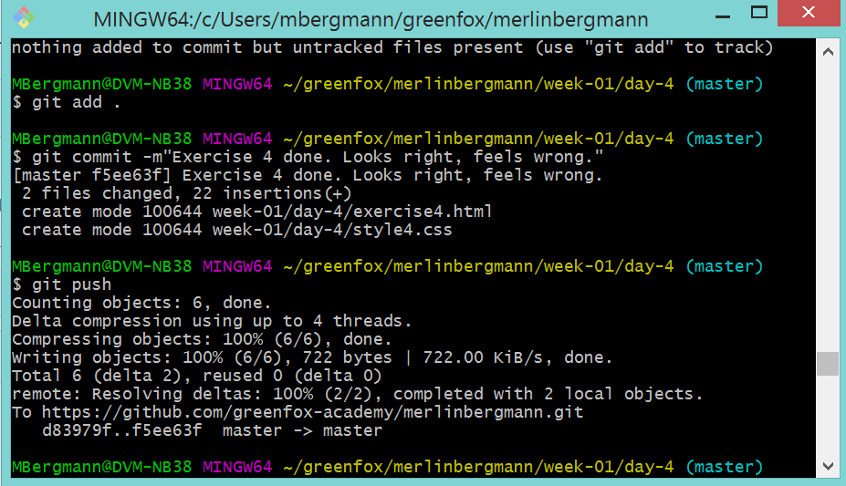
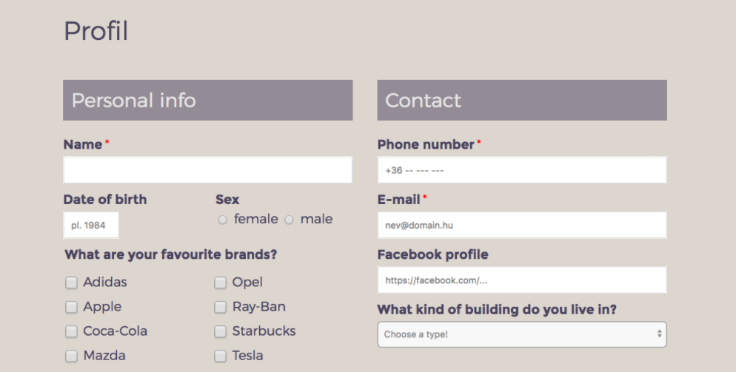
The good, the bad and the ugly
What I learned
The command line is my friend: navigating, organizing, pulling and pushing is a joy.
CSS is a massive crayon box and can make everything pretty.
HTML forms are surprisingly smart (if they‘re used in the right way)

Slide 4
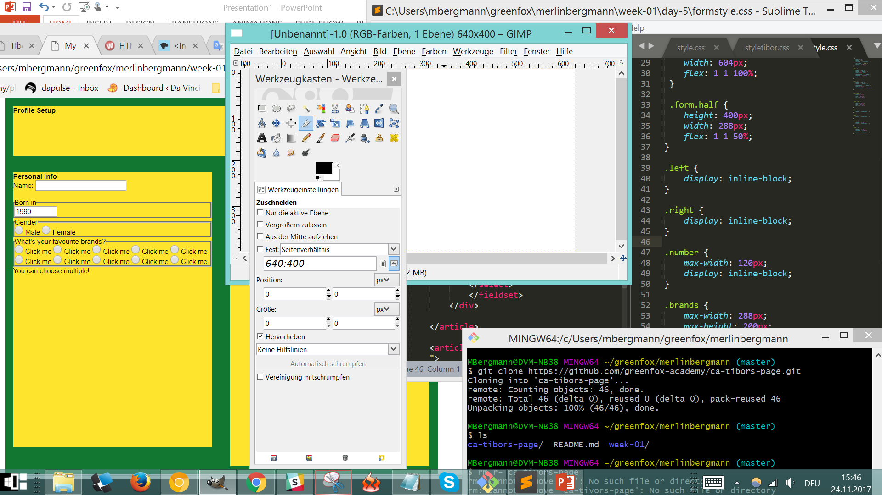
The good, the bad and the ugly
WTF?
50 open browser tabs, 12 apps running, multiple consoles... 4 large screens and a brain extension please!
Where is all the time gone?
Live coding is great – self coding is confusing
THE UGLY

Slide 5
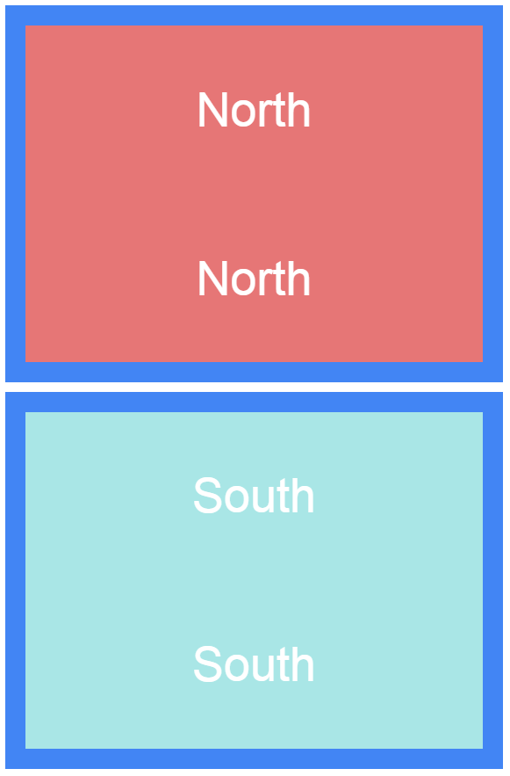
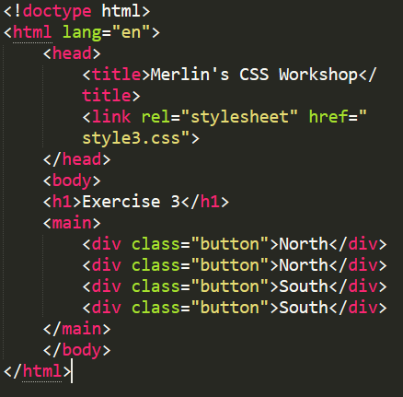
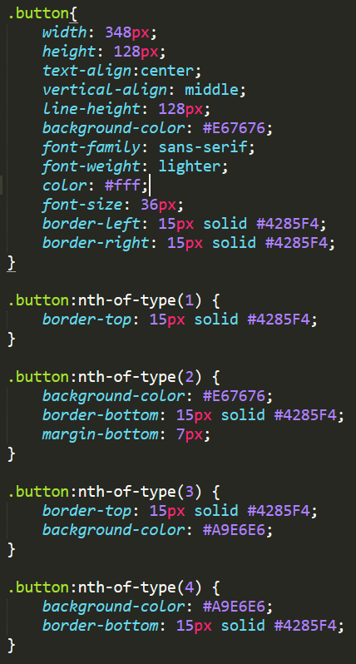
The good, the bad and the ugly

Slide 6
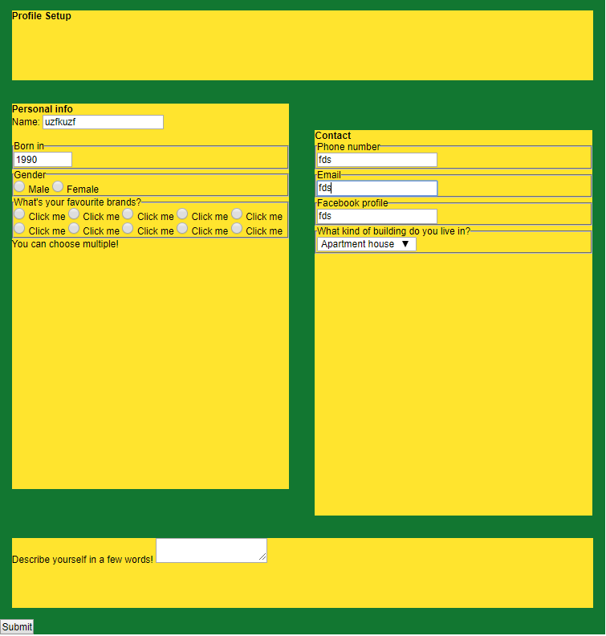

Slide 7
The good, the bad and the ugly
Memos to myself
Think and build in objects from the very beginning
Learn the editor shortcuts to save time
Enjoy the ride!

